Slide 1








生产及销售优质的通信产品，提供一站式解决方案及技术服务
To produce and sell high-quality communication products，and provide one-stop solutions and technical services.
南京轩微特微波技术有限公司
Nanjing Shinewave Technology Co.,LTD.
公司简介
Company Profile
南京轩微特技术有限公司成立于 2008 年，专业从事射频微波功率放大器、有源/无源器件及子系统的研发、生产与销售。公司依托知名高校科研团队，组建了一支由博士、硕士构成的创新研发队伍，并持续引进行业高端人才与优秀毕业生。
公司拥有约 20 项授权发明专利，覆盖微波器件、电路及天线等领域。产品服务于雷达、电子对抗、航空航天、导航等军工领域，同时也面向微波通信、移动通信等民用市场。
Founded in 2008, Nanjing Shinewave Technology specializes in the R&D, production and sales of RF microwave power amplifiers, active/passive devices and subsystems. Backed by research teams from renowned universities, it has built an innovative R&D team composed of doctors and masters, and keeps attracting top industrial talents and graduates.
The company owns about 20 authorized invention patents covering microwave devices, circuits and antennas. Its products serve military fields including radar, electronic countermeasure, aerospace and navigation, as well as civil markets such as microwave and mobile communications.
南京市雨花区软件大道180号大数据产业基地2栋
+86-13951873509
https://www.shinewave-tech.com
info@shinewave-tech.com

Slide 2









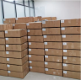



本图册为代表性规格产品，如需定制，可随时联系我司业务人员。
This catalog features representative products. For customization, please contact our sales team.
行业认证
Industry Certifications
定制能力
Customization Capabilities
了解产品
Product Understanding
按需定制
Customized on Demand
研发设计
R&D & Design
打包发货
Packaging & Delivery
产品测试
Product Testing
定制生产
Custom Manufacturing
南京市雨花区软件大道180号大数据产业基地2栋
+86-13951873509
https://www.shinewave-tech.com
info@shinewave-tech.com

Slide 3
本图册为代表性规格产品，如需定制，可随时联系我司业务人员。
This catalog features representative products. For customization, please contact our sales team.
主营代表产品 Representative Products
类型 | 型号 | 代表性波段 | 输出功率 | 页码
射频功放机箱 RF PA Chassis | SW-PA-0R0090250-57C | 9K–250 MHz | 500W | 4
 | SW-PA-00801000-59C | 80–1000 MHz | 850W | 6
 | SW-PA-10002000-55C | 1–2 GHz | 330W | 8
 | SW-PA-20006000-52C | 2–6 GHz | 150W | 10
 | SW-PA-04950505-67C | 495–505 MHz | 5KW | 12
 | SW-PA-600018000-51C | 6–18 GHz | 120W | 14
 | SW-TRMR-54005800-60C | 5.4–5.8 GHz | 1KW | 16
射频功放模块 RF PA Module | SW-PA-03002000-47C | 0.3–2 GHz | 50W | 18
 | SW-PA-20007200-47C | 2–7.2 GHz | 50W | 20
 | SW-PA-1000013000-43C | 10–13 GHz | 20W | 22
 | SW-PA-800012000-46C | 8–1 2GHz | 40W | 24
 | SW-PA-2400024250-42C | 24–24.25GHz | 16W | 26
干扰模块 Jammer Model | SW-PAJ-1070012750-50C | 10700–12750 MHz | 100W | 28
 | SW-PS-1070012800-43C | 10.7-12.8GHz | 20W | 30
 | SW-PS-04002000-47C | 2.4–2.5 GHz | 100W | 32
 | SW-PS-24002500-50C | 0.4–2 GHz | 50W | 34
 | SW-PS-57205860-51C | 5.72–5.86 GHz | 130W | 36
 | SW-JS-600010000-50C | 6–10 GHz | 100W | 38
变频模块&TRM&BUC | SW-TRM-10001200-50C-Diff RX | 1–1.2 GHz | 100W | 40
 | SW-TRM-85009500-47C | 8.5–9.5 GHz | 50W | 42
 | SW-BUC-1375014500-53C | 13.75-14.5GHz | 200W | 44
低噪声放大器 LNA | SWT177060 | 0.3–20 GHz | — | 46
 | SWT177062 | 1–18 GHz | — | 48
 | SWT177064 | 18–40 GHz | — | 50
南京市雨花区软件大道180号大数据产业基地2栋
+86-13951873509
https://www.shinewave-tech.com
info@shinewave-tech.com

Slide 4
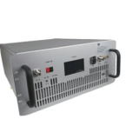
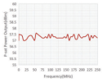




本图册为代表性规格产品，如需定制，可随时联系我司业务人员。
This catalog features representative products. For customization, please contact our sales team.
RF Power Amplifier
Model: SW-PA-0R0090250-57C
9K-250MHz 500W Amplifier(Rack Mount)
Output Power Curve Graph:
1. Products Specification
1.1 RF / ELECTRICAL
PARAMETER Operating Frequency RF INPUT Power Gain P-1dB Output Power P-sat Output Power Power Gain Flatness In/Out Impedance Spurious Signals Harmonic Signals Gain Adjust Range Gain Adjust Ste Operating Voltage Supply Power Input VSWR |  | UNIT MHz dBm dB W W dB Ω dBc dBc VAC W
MIN 0.009 57 300 500 200 | TYP. 0 ±4 50 -15 31.5 0.5 220 | MAX 250 5 -65 -8 260 3500 4
1.2 MECHANICAL
PARAMETER Dimensions (W x D x H) RF Connectors (Input / Output) Control Connector (Option1) Control Connector (Option2) Cooling Weight AC Connector | VALUE The standard 19-inch shelf is 5U high, 482*600*223 N-K / N-K (N female) DB9： Power on/power off control, gain control; Monitoring parameters include output power, temperature, supply voltage, and supply current RJ45： Remote control and monitoring can be realized through LAN Built-in cooling system, forced air cooling ≤40 Three-in-one air switch | UNIT mm -- -- -- kg
1.3 ENVIRONMENTAL / PROTECTIONS
PARAMETER
Operating Temp.
Housing Temp.
Amplifier Safeguard Temp.
Protections
MIN -25 +80 With over temperature protection, input over | MAX +55 +55 power protection, over
UNIT
。C
。C
。C
voltage protection, over current protection, output mismatch protection Maximum withstand standing wave 4:1
南京市雨花区软件大道180号大数据产业基地2栋
+86-13951873509
https://www.shinewave-tech.com
info@shinewave-tech.com

Slide 5
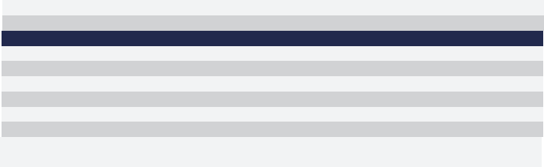
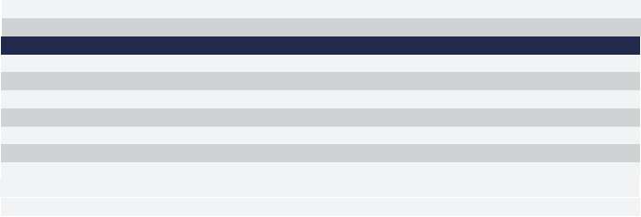
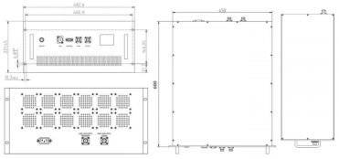
本图册为代表性规格产品，如需定制，可随时联系我司业务人员。
This catalog features representative products. For customization, please contact our sales team.
1.4 INPUT/OUTPUT panel Connector
AMPLIFIER CONNECTOR TYPE:
TRIAD CABLE PART NUMBER:
DESCRIPTION
RF IN RF OUT
Human-computer interaction interface
AC/220V/50Hz
LAN
DB9
N-FK
N-FK
——
NUMBER
X1
X2
X3
X4
X5
X6
X7
X8
interface type
N-FK
N-FK
LCD display
Three-in-one air switch
RJ45
——
Control interface
Forward coupling port
Reverse coupling port
1.5 Connector Definition
AMPLIFIER CONNECTOR TYPE:
TRIAD CABLE PART NUMBER:
DESCRIPTION
TTL Hi= Enable, TTL Lo = Disable or No Connection
Output Power Detection (TTL Hi= Normal , TTL Lo =Fault ) Temp monitoring alarm (TTL Hi= Normal , TTL Lo =Fault ) Voltage monitoring alarm (TTL Hi= Normal , TTL Lo =Fault ) Current monitoring alarm (TTL Hi= Normal , TTL Lo =Fault )
RXD
TXD
GND
NC
——
NUMBER
1
2
3
4
5
6
7
8
9
Definition
——
PA Enable
Output Power monitoring
Temp monitoring
Voltage monitoring
Current monitoring
RS232 serial bus interface, PA gain adjustment
NC
2. Outline Dimension Drawing (unit:mm)
南京市雨花区软件大道180号大数据产业基地2栋
+86-13951873509
https://www.shinewave-tech.com
info@shinewave-tech.com

Slide 6
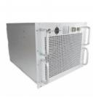

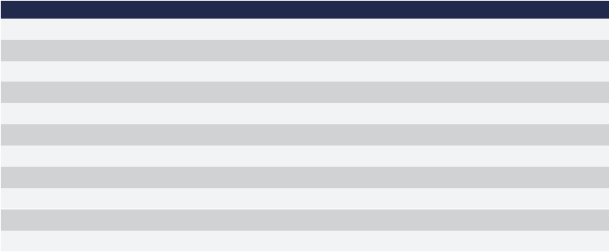


本图册为代表性规格产品，如需定制，可随时联系我司业务人员。
This catalog features representative products. For customization, please contact our sales team.
RF Power Amplifier
80-1000MHz 850W Amplifier(Rack Mount)
Model: SW-PA-00801000-59C
Output Power Curve Graph:
1. Products Specification
1.1 RF / ELECTRICAL
TyPicaI Performance at 220v AC +25oC, and in a 50Ω system.
PARAMETER
Operating Frequency RF INPUT
Power Gain
P-sat Output Power Power Gain Flatness
In/Out Impedance Spurious Signals Harmonic Signals Operating Voltage Supply Power
Input VSWR
MIN 80 59.3 59.3 200 | TYP. 0 ±4 50 -50 -15 220 | MAX 1000 5 260 3500 2
UNIT
MHz
dBm
dB
dBm
dB
Ω
dBc
dBc
V AC
W
1.2 MECHANICAL
PARAMETER
Dimensions (W x D x H)
RF Connectors (Input / Output)
Control Connector (Option1)
Control Connector (Option2) Cooling
Weight
VALUE
The standard 19-inch shelf is 5U high, 482*600*223
N-K / N-K (N female)
DB15： Power on/power off control; Gain Control; Monitoring parameters
include output power, temperature
Remote control and monitoring can be realized through RS232
RJ45： Remote control and monitoring can be realized through LAN
Built-in cooling system, forced air cooling
≤45
UNIT
mm
--
--
--
kg
1.3 ENVIRONMENTAL / PROTECTIONS
PARAMETER
Operating Temp.
Humidity Range
Amplifier Safeguard Temp.
Protections
MIN
0
MAX
+55
UNIT
。C
%
。C
0-90
+80
With over temperature protection, input over power protection, output mismatch protection Maximum withstand standing wave 4:1
南京市雨花区软件大道180号大数据产业基地2栋
+86-13951873509
https://www.shinewave-tech.com
info@shinewave-tech.com

Slide 7
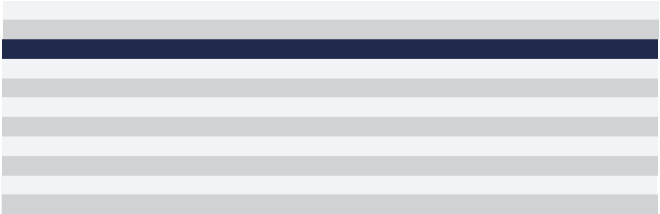
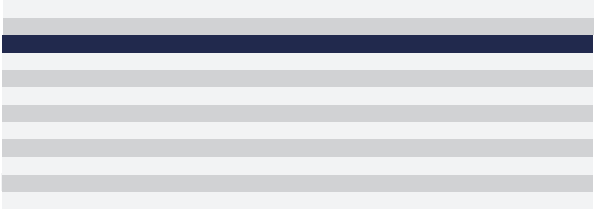
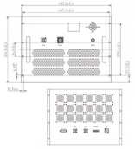
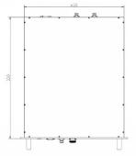
本图册为代表性规格产品，如需定制，可随时联系我司业务人员。
This catalog features representative products. For customization, please contact our sales team.
1.4 INPUT/OUTPUT PANEL CONNECTOR
AMPLIFIER CONNECTOR TYPE: |  | ——
TRIAD CABLE PART NUMBER: |  | ——
NUMBER X1 X2 X3 X4 X5 X6 X7 X8 | interface type N-FK 7/16(f) LCD display Switch RJ45 DB15 N-FK N-FK | DESCRIPTION RF IN RF OUT Human-computer interaction interface AC/220V/50Hz LAN Control interface Forward coupling port Reverse coupling port
1.5 CONNECTOR DEFINITION
AMPLIFIER CONNECTOR TYPE: |  | DB15
TRIAD CABLE PART NUMBER: |  | ——
NUMBER 1 2 3 4 5 6 7 8 9-15 | Definition PA Enable Output Power monitoring Reverse Power monitoring Temp monitoring GND RXD TXD GND NC | DESCRIPTION TTL Hi= Enable, TTL Lo = Disable or No Connection Output Power Detection (Output analog voltage) Reverse Power Detection (Output analog voltage) Temp monitoring alarm (Output analog voltage) GND NC
RS232 serial bus interface （ TTL）
2. Outline Dimension Drawing (unit:mm)
南京市雨花区软件大道180号大数据产业基地2栋
+86-13951873509
https://www.shinewave-tech.com
info@shinewave-tech.com

Slide 8
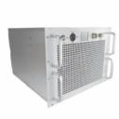




本图册为代表性规格产品，如需定制，可随时联系我司业务人员。
This catalog features representative products. For customization, please contact our sales team.
RF Power Amplifier
1-2GHz 330W Amplifier(Rack Mount)
Model: SW-PA-10002000-55C
Output Power Curve Graph:
1. Products Specification
1.1 RF / Electrical
TyPicaI Performance at 220v AC +25oC, and in a 50Ω system.
PARAMETER
Operating Frequency
RF INPUT
Power Gain
P-sat Output Power
Power Gain Flatness
In/Out Impedance
Spurious Signals
Harmonic Signals
Operating Voltage
Supply Power
Input VSWR
MIN 1000 55.5 55.5 200 | TYP. 0 56 56 ±2.5 50 -50 -15 220 | MAX 2000 5 260 1500 2
UNIT
MHz
dBm
dB
dBm
dB
Ω
dBc
dBc
VAC
W
1.2 Mechanical
PARAMETER
Dimensions (W x D x H)
RF Connectors (Input / Output)
Control Connector (Option1)
Control Connector (Option2) Cooling
Weight
VALUE
The standard 19-inch shelf is 8U high, 482*550*356
N-K / N-K (female)
DB15： Power on/power off control; Gain Control; Monitoring parameters
include output power, temperature
Remote control and monitoring can be realized through RS232
UNIT
mm
--
--
--
kg
RJ45： Remote control and monitoring can be realized through LAN
Built-in cooling system, forced air cooling
≤45
1.3 Environmental / Protections
PARAMETER
Operating Temp.
Humidity Range
Amplifier Safeguard Temp.
Protections
MIN
-25
MAX
+55
UNIT
。C
%
。C
0-90
+80
With over temperature protection, input over power protection, output mismatch protection Maximum withstand standing wave 4:1
南京市雨花区软件大道180号大数据产业基地2栋
+86-13951873509
https://www.shinewave-tech.com
info@shinewave-tech.com

Slide 9
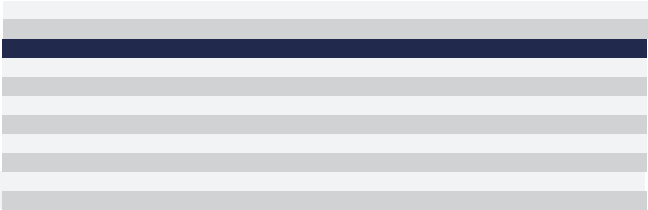
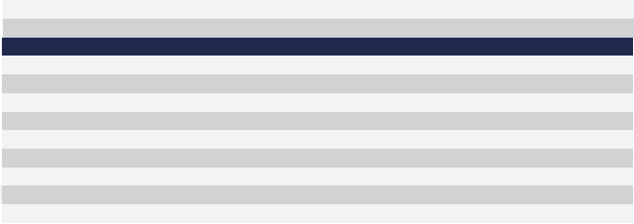
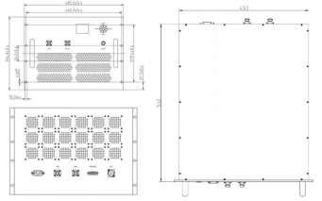
本图册为代表性规格产品，如需定制，可随时联系我司业务人员。
This catalog features representative products. For customization, please contact our sales team.
1.4 INPUT/OUTPUT Panel Connector
AMPLIFIER CONNECTOR TYPE: |  | ——
TRIAD CABLE PART NUMBER: |  | ——
NUMBER X1 X2 X3 X4 X5 X6 X7 X8 | interface type N-K N-K LCD display Switch RJ45 DB15 N-FK N-FK | DESCRIPTION RF IN RF OUT Human-computer interaction interface AC/220V/50Hz LAN Control interface Forward coupling port Reverse coupling port
1.5 Connector Definition
AMPLIFIER CONNECTOR TYPE: |  | DB15
TRIAD CABLE PART NUMBER: |  | ——
NUMBER 1 2 3 4 5 6 7 8 9-15 | Definition PA Enable Output Power monitoring Reverse Power monitoring Temp monitoring GND RXD TXD GND NC | DESCRIPTION TTL Hi= Enable, TTL Lo = Disable or No Connection Output Power Detection (Output analog voltage) Reverse Power Detection (Output analog voltage) Temp monitoring alarm (Output analog voltage) GND NC
RS232 serial bus interface （ TTL）
2. Outline Dimension Drawing (unit:mm)
南京市雨花区软件大道180号大数据产业基地2栋
+86-13951873509
https://www.shinewave-tech.com
info@shinewave-tech.com

Slide 10
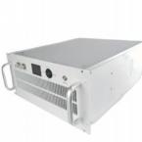
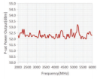



本图册为代表性规格产品，如需定制，可随时联系我司业务人员。
This catalog features representative products. For customization, please contact our sales team.
RF Power Amplifier
2-6GHz 150W Amplifier(Rack Mount)
Model: SW-PA-20006000-52C
Output Power Curve Graph:
1. Products Specification
1.1 RF / Electrical
Typical performance at 220V AC +25。C, and in a 50Ω system.
PARAMETER
Operating Frequency
RF INPUT
Power Gain
P-sat Output Power
Power Gain Flatness
In/Out Impedance
Spurious Signals
Harmonic Signals
Operating Voltage
Supply Power
Input VSWR
MIN 2000 52 52 200 | TYP. 0 ±4 50 -50 -15 220 | MAX 6000 5 260 2000 2
UNIT
MHz
dBm
dB
dBm
dB
Ω
dBc
dBc
VAC
W
1.2 Mechanical
PARAMETER
Dimensions (W x D x H)
RF Connectors (Input / Output)
Control Connector (Option1)
Control Connector (Option2) Cooling
Weight
VALUE
The standard 19-inch shelf is 5U high, 482*550*223
N-K / N-K (female)
DB15： Power on/power off control; Gain Control; Monitoring parameters
include output power, temperature
Remote control and monitoring can be realized through RS232
RJ45： Remote control and monitoring can be realized through LAN
Built-in cooling system, forced air cooling
≤35
UNIT
mm
--
--
--
kg
1.3 Environmental / Protections
PARAMETER
Operating Temp.
Humidity Range
Amplifier Safeguard Temp.
Protections
MIN
-25
MAX
+55
UNIT
。C
%
。C
0-90
+80
With over temperature protection, input over power protection, output mismatch protection Maximum withstand standing wave 4:1
南京市雨花区软件大道180号大数据产业基地2栋
+86-13951873509
https://www.shinewave-tech.com
info@shinewave-tech.com

Slide 11

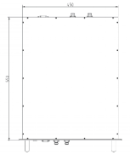




本图册为代表性规格产品，如需定制，可随时联系我司业务人员。
This catalog features representative products. For customization, please contact our sales team.
1.4 INPUT/OUTPUT Panel Connector
AMPLIFIER CONNECTOR TYPE: |  | ——
TRIAD CABLE PART NUMBER: |  | ——
NUMBER X1 X2 X3 X4 X5 X6 X7 X8 | interface type N-FK N-FK LCD display Switch RJ45 DB15 N-FK N-FK | DESCRIPTION RF IN RF OUT Human-computer interaction interface AC/220V/50Hz LAN Control interface Forward coupling port Reverse coupling port
1.5 Connector Definition
AMPLIFIER CONNECTOR TYPE: |  | DB15
TRIAD CABLE PART NUMBER: |  | ——
NUMBER 1 2 3 4 5 6 7 8 9-15 | Definition PA Enable Output Power monitoring Reverse Power monitoring Temp monitoring GND RXD TXD GND NC | DESCRIPTION TTL Hi= Enable, TTL Lo = Disable or No Connection Output Power Detection (Output analog voltage) Reverse Power Detection (Output analog voltage) Temp monitoring alarm (Output analog voltage) GND NC
RS232 serial bus interface （ TTL）
2. Outline Dimension Drawing (unit:mm)
南京市雨花区软件大道180号大数据产业基地2栋
+86-13951873509
https://www.shinewave-tech.com
info@shinewave-tech.com

Slide 12
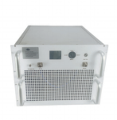
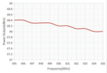
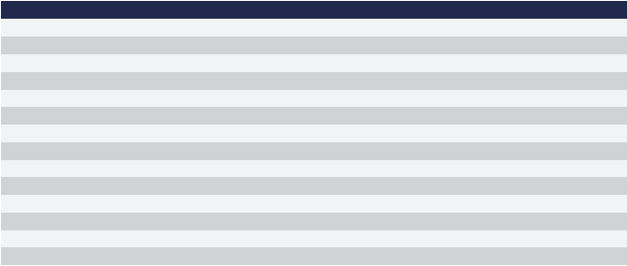


本图册为代表性规格产品，如需定制，可随时联系我司业务人员。
This catalog features representative products. For customization, please contact our sales team.
RF Power Amplifier
495-505MHz 5KW Amplifier(Rack Mount)
Model: SW-PA-04950505-67C
Output Power Curve Graph:
1. Products Specification
1.1 RF / Electrical
Typical performance at 220V AC +25。C, and in a 50Ω system.
PARAMETER
Operating Frequency
RF INPUT
Power Gain
P-sat Output Power
Small Signal Gain Flatness
Power Gain Flatness
In/Out Impedance
Spurious Signals
Harmonic Signals
Phase drift coefficient
Gain drift coefficient
Operating Voltage
Supply Power
Input/Output VSWR
MIN 495 67 60 200 | TYP. 0 ±1 ±1 50 -60 -20 220 | MAX 505 5 67 0.5 1.5 260 1000 2
UNIT
MHz
dBm
dB
dBm
dB
dB
Ω
dBc
dBc
deg / ℃ % / K
VAC
W
1.2 Mechanical
PARAMETER
Dimensions (W x D x H)
RF Connectors (Input / Output)
Control Connector (Option1)
Control Connector (Option2) Cooling
Weight
VALUE
The standard 19-inch shelf is 8U high, 482*550*356
N-K / 1-5/8 type (female)
DB15： Power on/power off control; Gain Control; Monitoring parameters
include output power, temperature
Remote control and monitoring can be realized through RS232
RJ45： Remote control and monitoring can be realized through LAN
Built-in cooling system, forced air cooling
≤50
UNIT
mm
--
--
--
kg
1.3 Environmental / Protections
PARAMETER
Operating Temp.
Humidity Range
Amplifier Safeguard Temp.
Protections
MIN
-25
MAX
+55
UNIT
。C
%
。C
0-90
+80
With over temperature protection, input over power protection, output mismatch protection VSWR 4:1
南京市雨花区软件大道180号大数据产业基地2栋
+86-13951873509
https://www.shinewave-tech.com
info@shinewave-tech.com

Slide 13
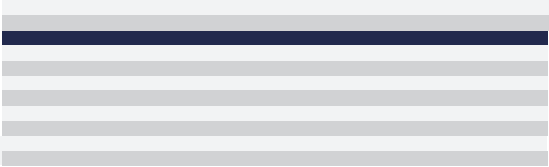
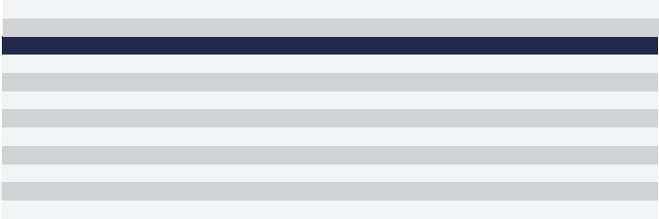
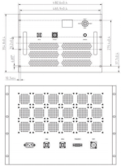
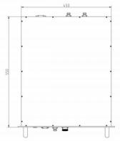
本图册为代表性规格产品，如需定制，可随时联系我司业务人员。
This catalog features representative products. For customization, please contact our sales team.
1.4 INPUT/OUTPUT panel Connector
AMPLIFIER CONNECTOR TYPE: TRIAD CABLE PART NUMBER: |  | —— ——
NUMBER X1 X2 X3 X4 X5 X6 X7 X8 | interface type N-FK 1-5/8 type LCD display Switch RJ45 DB15 N-FK N-FK | DESCRIPTION RF IN RF OUT Human-computer interaction interface AC/220V/50Hz LAN Control interface Forward coupling port Reverse coupling port
1.5 Connector Definition
AMPLIFIER CONNECTOR TYPE: TRIAD CABLE PART NUMBER: |  |  | DB15
NUMBER 1 2 3 4 5 6 7 8 9-15 | Definition PA Enable Output Power monitoring Reverse Power monitoring Temp monitoring GND RXD TXD GND NC |  | DESCRIPTION TTL Hi= Enable, TTL Lo = Disable or No Connection Output Power Detection (Output analog voltage) Reverse Power Detection (Output analog voltage) Temp monitoring alarm (Output analog voltage) GND
 |  |  | NC
2. Outline Dimension Drawing (unit:mm)
RS232 serial bus interface （ TTL）
南京市雨花区软件大道180号大数据产业基地2栋
+86-13951873509
https://www.shinewave-tech.com
info@shinewave-tech.com

Slide 14
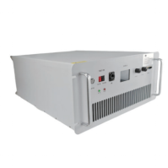



本图册为代表性规格产品，如需定制，可随时联系我司业务人员。
This catalog features representative products. For customization, please contact our sales team.
1. Products Specification
1.1 RF / Electrical
Typical performance at 220V AC +25。C, and in a 50Ω system.
RF Power Amplifier
6-18GHz 120W Amplifier(Rack Mount) Model: SW-PA-600018000-51C
Output Power Curve Graph:
PARAMETER
Operating Frequency RF INPUT
Power Gain
P-sat Output Power Power Gain Flatness In/Out Impedance
Spurious Signals Harmonic Signals Operating Voltage Supply Power
Input VSWR
MIN
6000
51
51
200
TYP.
0
±4
50
-50
-15
220
MAX
18000
5
260
2000
2
UNIT
MHz
dBm
dB
dBm
dB
Ω
dBc
dBc
VAC
W
1.2 Mechanical
PARAMETER
Dimensions (W x D x H)
RF Connectors (Input / Output)
Control Connector (Option1)
Control Connector (Option2) Cooling
Weight
VALUE
The standard 19-inch shelf is 5U high, 482*550*223
N-K / N-K (female)
DB15： Power on/power off control; Gain Control; Monitoring parameters
include output power, temperature
Remote control and monitoring can be realized through RS232
RJ45： Remote control and monitoring can be realized through LAN
Built-in cooling system, forced air cooling
≤35
UNIT
mm
--
--
--
--
kg
1.3 Environmental / Protections
PARAMETER
Operating Temp.
Humidity Range
Amplifier Safeguard Temp.
Protections
MIN
-25
MAX
+55
UNIT
。C
%
。C
0-90
+80
With over temperature protection, input over power protection, output mismatch protection Maximum withstand standing wave 4:1
南京市雨花区软件大道180号大数据产业基地2栋
+86-13951873509
https://www.shinewave-tech.com
info@shinewave-tech.com

Slide 15

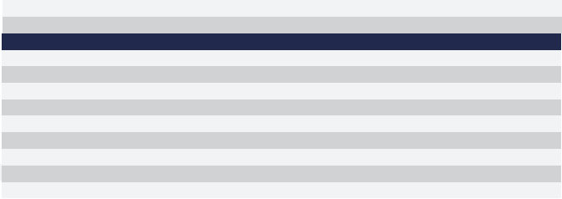

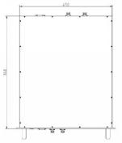

本图册为代表性规格产品，如需定制，可随时联系我司业务人员。
This catalog features representative products. For customization, please contact our sales team.
1.4 INPUT/OUTPUT Panel Connector
AMPLIFIER CONNECTOR TYPE: |  | ——
TRIAD CABLE PART NUMBER: |  | ——
NUMBER X1 X2 X3 X4 X5 X6 X7 X8 | interface type N-FK N-FK LCD display Switch RJ45 DB15 N-FK N-FK | DESCRIPTION RF IN RF OUT Human-computer interaction interface AC/220V/50Hz LAN Control interface Forward coupling port Reverse coupling port
1.5 Connector Definition
AMPLIFIER CONNECTOR TYPE: |  | DB15
TRIAD CABLE PART NUMBER: |  | ——
NUMBER 1 2 3 4 5 6 7 8 9-15 | Definition PA Enable Output Power monitoring Reverse Power monitoring Temp monitoring GND RXD TXD GND NC | DESCRIPTION TTL Hi= Enable, TTL Lo = Disable or No Connection Output Power Detection (Output analog voltage) Reverse Power Detection (Output analog voltage) Temp monitoring alarm (Output analog voltage) GND NC
RS232 serial bus interface （ TTL）
2. Outline Dimension Drawing (unit:mm)
南京市雨花区软件大道180号大数据产业基地2栋
+86-13951873509
https://www.shinewave-tech.com
info@shinewave-tech.com

Slide 16
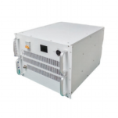

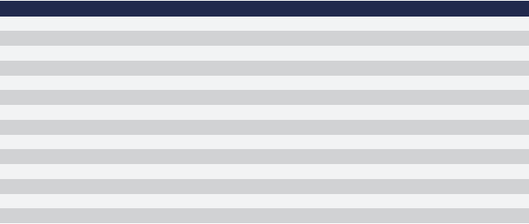


本图册为代表性规格产品，如需定制，可随时联系我司业务人员。
This catalog features representative products. For customization, please contact our sales team.
RF Power Amplifier
5.4-5.8GHz 1KW Amplifier(Rack Mount)
Model: SW-TRMR-54005800-60C
1. Products Specification
Output Power Curve Graph:
1.1 RF / ELECTRICAL
Typical performance at 220V AC +25。C, and in a 50Ω system.
PARAMETER
Operating Frequency
RF INPUT
Power Gain
P-1dB Output Power
P-sat Output Power Power Gain Flatness
In/Out Impedance Spurious Signals Harmonic Signals RX Gain
Noise Figure
Operating Voltage Supply Power
Input VSWR
MIN 5400 200 | TYP. -10 70 60 ±1.5 50 -60 -20 45 220 | MAX 5800 10 5 260 2000 2
UNIT
MHz
dBm
dB
W
W
dB
Ω
dBc
dBc
dB
dB
VAC
W
1.2 MECHANICAL
PARAMETER
Dimensions (W x D x H)
RF Connectors (Input / Output)
Control Connector
Control Connector
Cooling
Weight
VALUE
The standard 19-inch shelf is 8U high, 482*550*356
N-K / N-K (female)
DB15： Power on/power off control; Gain Control; Monitoring parameters
include output power, temperature
Remote control and monitoring can be realized through RS232
RJ45： Remote control and monitoring can be realized through LAN
Built-in cooling system, forced air cooling
≤60
UNIT
mm
--
--
--
kg
1.3 ENVIRONMENTAL / PROTECTIONS
PARAMETER
Operating Temp.
Humidity Range
Amplifier Safeguard Temp.
Protections
MIN
0
MAX
+45
UNIT
。C
%
。C
0-90
+80
With over temperature protection, input over power protection, output mismatch protection
南京市雨花区软件大道180号大数据产业基地2栋
+86-13951873509
https://www.shinewave-tech.com
info@shinewave-tech.com

Slide 17
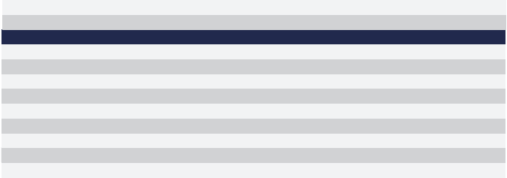
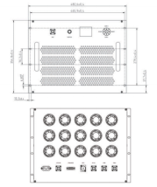
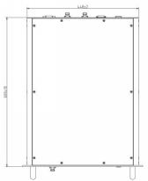
本图册为代表性规格产品，如需定制，可随时联系我司业务人员。
This catalog features representative products. For customization, please contact our sales team.
1.4 INPUT/OUTPUT panel Connector
AMPLIFIER CONNECTOR TYPE: |  | ——
TRIAD CABLE PART NUMBER: |  | ——
NUMBER X1 X2 X3 X4 X5 X6 X7 X8 | interface type N-FK N-FK LCD display Switch RJ45 DB15 N-FK N-FK | DESCRIPTION RF IN RF OUT Human-computer interaction interface AC/220V/50Hz LAN Control interface Forward coupling port Reverse coupling port
1.5 Connector Definition
AMPLIFIER CONNECTOR TYPE: |  | DB15
TRIAD CABLE PART NUMBER: |  | ——
NUMBER 1 2 3 4 5 6 7 8 9-15 | Definition PA Enable Output Power monitoring Reverse Power monitoring Temp monitoring GND RXD TXD GND NC | DESCRIPTION TTL Hi= Enable, TTL Lo = Disable or No Connection Output Power Detection (Output analog voltage) Reverse Power Detection (Output analog voltage) Temp monitoring alarm (Output analog voltage) GND NC
RS232 serial bus interface （ TTL）
2. Outline Dimension Drawing (unit:mm)
南京市雨花区软件大道180号大数据产业基地2栋
+86-13951873509
https://www.shinewave-tech.com
info@shinewave-tech.com

Slide 18
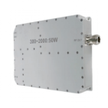
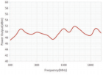


本图册为代表性规格产品，如需定制，可随时联系我司业务人员。
This catalog features representative products. For customization, please contact our sales team.
RF Power Amplifier
0.3~2GHz 50W Amplifier Module
Model: SW-PA-03002000-47C
Output Power Curve Graph:
1. Products Specification
1.1 Technical Specifications
Technical Parameter
Operating Frequency
Saturated Output Power
Input Power
Power Gain
Input/Output Impedance
Power Supply
Power Dissipation
Operating Temperature Range
Dimensions
Weight
Cooling
Code
BW
Psat
Pin
Gain
I/O-IMP
Vdc
Pdiss
OT
DM
WT
Cooling
Min
0.3
TYP
Max
2
Unit
GHz
W
dBm
dB
Ω
V
W
℃
50
0
47
50
28
240
+25
30
300
+55
-20
160×120×30mm
≤1.5kg
External heatsink required
1.2 Interface Definition
Port ID | Connector Type | Function | Remarks
RFIN | SMA-K | RF Input
RFOUT DC | N-K DSUB 2W2 (Male) | RF Output Power Supply
南京市雨花区软件大道180号大数据产业基地2栋
+86-13951873509
https://www.shinewave-tech.com
info@shinewave-tech.com

Slide 19

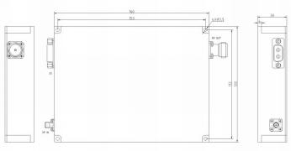
本图册为代表性规格产品，如需定制，可随时联系我司业务人员。
This catalog features representative products. For customization, please contact our sales team.
1.3 DSUB 2W2 Male Connector Pinout
Pin | Label | Function | Remarks
A1 | VDD | +28V | Positive power supply
A2 | GND | GND | Power return
2. Outline Dimension Drawing (unit:mm)
南京市雨花区软件大道180号大数据产业基地2栋
+86-13951873509
https://www.shinewave-tech.com
info@shinewave-tech.com

Slide 20
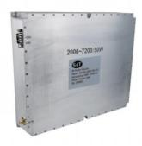
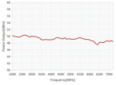

本图册为代表性规格产品，如需定制，可随时联系我司业务人员。
This catalog features representative products. For customization, please contact our sales team.
RF Power Amplifier 2-7.2GHz 50WAmplifier Module Model: SW-PA-20007200-47C
1. Products Specification |  | Output Power Curve Graph:
1.1 Technical Specifications
Technical Parameter | Code | Min | TYP | Max | Unit
Operating Frequency | BW | 2 |  | 7.2 | GHz
Saturated Output Power | Psat |  | 50 |  | W
Input Power | Pin |  | 0 |  | dBm
Power Gain | Gain |  | 50 |  | dB
Input/Output Impedance | I/O-IMP |  | 50 |  | Ω
Power Supply | Vdc |  | 28 | 30 | V
Power Dissipation | Pdiss |  | 300 | 500 | W
Operating Temperature Range | OT | -20 | +25 | +55 | ℃
Dimensions | DM | 250×220×40mm
Weight | WT | No more than 7kg
Cooling Cooling |  | A radiator is required to dissipate heat
南京市雨花区软件大道180号大数据产业基地2栋
+86-13951873509
https://www.shinewave-tech.com
info@shinewave-tech.com

Slide 21


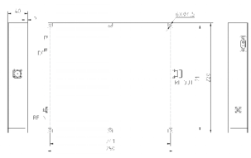
本图册为代表性规格产品，如需定制，可随时联系我司业务人员。
This catalog features representative products. For customization, please contact our sales team.
1.2 Interface Definition
Port ID | Connector Type |  |  | Function | Remarks
RFIN | SMA-K |  |  | RF Input
RFOUT DC | N-K DSUB 2W2 (Male) |  |  | RF Output Power Supply
1.3 DSUB 2W2 Male Connector Pinout
Pin | Label | Function | Remarks
A1 | VDD | +28V | Positive power supply
A2 | GND | GND | Power return
2. Outline Dimension Drawing (unit:mm)
南京市雨花区软件大道180号大数据产业基地2栋
+86-13951873509
https://www.shinewave-tech.com
info@shinewave-tech.com

Slide 22
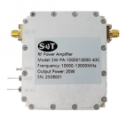
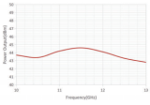
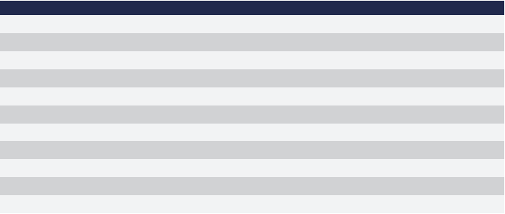

本图册为代表性规格产品，如需定制，可随时联系我司业务人员。
This catalog features representative products. For customization, please contact our sales team.
RF Power Amplifier
10-13GHz 20WAmplifier Module Model: SW-PA-1000013000-43C
Output Power Curve Graph:
1. Products Specification
1.1 RF / ELECTRICAL
Typical performance at 220V AC +25。C, and in a 50Ω system.
PARAMETER
Operating Frequency
RF INPUT
Power Gain
P-sat Output Power
Power Gain Flatness
In/Out Impedance
Spurious Signals
Harmonic Signals
Operating Voltage
Current
Input VSWR
MIN 10000 0 42 28 | TYP. 3 43 43 ±1.5 50 -50 -15 30 3 1.8 | MAX 13000 5 45 -10 32 2
UNIT
MHz
dBm
dB
dBm
dB
Ω
dBc
dBc
VAC
A
1.2 MECHANICAL
PARAMETER
Dimensions (W x D x H)
RF Connectors (Input / Output)
DC / Control Connector
Cooling
Mounting
Weight
VALUE
60*70* 15
SMA female/SMA female
Feeding Capacitor
Consider heat dissipation with the system
3-6 Thru Hole
≤1.5
UNIT
mm
--
--
--
kg
南京市雨花区软件大道180号大数据产业基地2栋
+86-13951873509
https://www.shinewave-tech.com
info@shinewave-tech.com

Slide 23


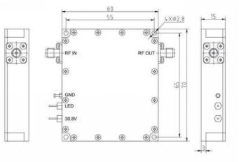
本图册为代表性规格产品，如需定制，可随时联系我司业务人员。
This catalog features representative products. For customization, please contact our sales team.
1.3 ENVIRONMENTAL / PROTECTIONS
PARAMETER MIN MAX UNIT
Operating Temp. (Housing Temp.) |  | -40 |  | +60 | 。C
Humidity Range |  |  | 0- | 100 | %
PA Baseplate Shutoff Temperature |  |  | +80 |  | 。C
1.4 INPUT/OUTPUT panel Connector
AMPLIFIER CONNECTOR TYPE:: óó
TRIAD CABLE PART NUMBER: ^{óó}
Port ID | Connector Type |  | DESCRIPTION
X1 | SMA female |  | RF Input
X2 | SMA female |  | RF Output
X3 | Feeding Capacitor |  | DC and Control Interface
2. Outline Dimension Drawing ^{(unit:mm)}
南京市雨花区软件大道180号大数据产业基地2栋
+86-13951873509
https://www.shinewave-tech.com
info@shinewave-tech.com

Slide 24
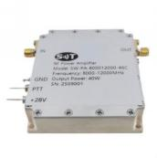


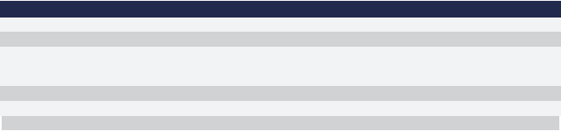
本图册为代表性规格产品，如需定制，可随时联系我司业务人员。
This catalog features representative products. For customization, please contact our sales team.
RF Power Amplifier
8-12GHz 40WAmplifier Module
Model: SW-PA-800012000-46C
1. Products Specification
Output Power Curve Graph:
1.1 RF / ELECTRICAL
Typical performance at 220V AC +25。C, and in a 50Ω system.
PARAMETER
Operating Frequency
RF INPUT
Power Gain
P-sat Output Power
Power Gain Flatness
In/Out Impedance
Spurious Signals
Harmonic Signals
Operating Voltage
Current
Input VSWR
MIN 8000 0 | TYP. 4 46 46 ±1.5 50 -50 -15 28 8 2 | MAX 12000 6 -10 10 2
UNIT
MHz
dBm
dB
dBm
dB
Ω
dBc
dBc
VAC
A
1.2 MECHANICAL
PARAMETER
Dimensions (L x W x H)
RF Connectors (Input / Output)
DC / Connector
Cooling
Mounting
Weight
VALUE
60*70*15
SMA female/SMA female
Feeding Capacitor
Consider heat dissipation with the system
3-6 Thru Hole
≤1.5
UNIT
mm
--
--
--
kg
南京市雨花区软件大道180号大数据产业基地2栋
+86-13951873509
https://www.shinewave-tech.com
info@shinewave-tech.com

Slide 25

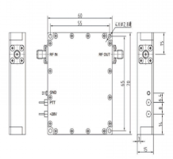
本图册为代表性规格产品，如需定制，可随时联系我司业务人员。
This catalog features representative products. For customization, please contact our sales team.
1.3 ENVIRONMENTAL / PROTECTIONS
PARAMETER | MIN MAX | UNIT
Operating Temp. (Housing Temp.) | +50 | 。C
Humidity Range | 0-100 | %
PA Baseplate Shutoff Temperature | +90 | 。C
-20
1.4 INPUT/OUTPUT PINS
_{AMPLIFIER} _{CONNECTOR} _{TYPE::} ^{óó}
TRIAD CABLE PART NUMBER: ^{óó}
DESCRIPTION
RF IN
RF OUT
+28V
PTT : TTL Hi = Enable, TTL Lo or No Connection = Disable
PIN
NUMBER
1
2
3
4
LABEL
SMA female
SMA female
Feeding Capacitor
Feeding Capacitor
2. Outline Dimension Drawing (unit:mm)
南京市雨花区软件大道180号大数据产业基地2栋
+86-13951873509
https://www.shinewave-tech.com
info@shinewave-tech.com

Slide 26
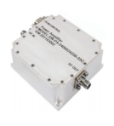
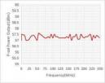
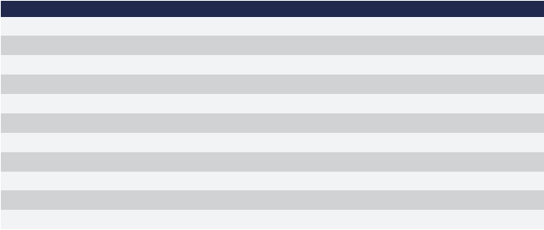

本图册为代表性规格产品，如需定制，可随时联系我司业务人员。
This catalog features representative products. For customization, please contact our sales team.
RF Power Amplifier
24-24.25GHz 2W Amplifier Module
Model: SW-PA-2400024250-33C
Output Power Curve Graph:
1. Products Specification
1.1 RF / ELECTRICAL
Typical performance at 220V AC +25。C, and in a 50Ω system.
PARAMETER
Operating Frequency RF INPUT
Power Gain
P-sat Output Power Power Gain Flatness
In/Out Impedance Spurious Signals Harmonic Signals Operating Voltage power dissipation Input VSWR
MIN 24000 18 | TYP. 0 33 33 ±1.5 50 -60 -15 24 280 | MAX 24250 28 350 2
UNIT
MHz
dBm
dB
dB
dB
Ω
dBc
dBc
V DC
W
1.2 MECHANICAL
PARAMETER
Dimensions (L x W x H)
RF Connectors (Input / Output) DC & Control Connector
Cooling
Mounting
Weight
VALUE
63*61*24
2.92-F / 2.92-F
J30J-9ZKP： PA on/off control; Over-Temperature alarm
Base heat dissipation
φ3-4 Thru HOIe
≤0.5
UNIT
mm
--
--
--
--
kg
1.3 ENVIRONMENTAL / PROTECTIONS
PARAMETER MIN MAX UNIT
Operating Temp. (Housing Temp.) | -20 | +60 | 。C
Humidity Range | -40 | +80 | 。C
PA Baseplate Shutoff Temperature | 0-95 |  | %
南京市雨花区软件大道180号大数据产业基地2栋
+86-13951873509
https://www.shinewave-tech.com
info@shinewave-tech.com

Slide 27



本图册为代表性规格产品，如需定制，可随时联系我司业务人员。
This catalog features representative products. For customization, please contact our sales team.
1.4 Interface Definition
AMPLIFIER CONNECTOR TYPE: |  | óó
TRIAD CABLE PART NUMBER: |  | óó
NUMBER X1 X2 X3 | interface type SMA- KFD SMA- KFD J30J-9ZKP | Remarks RF IN RF OUT DC / Control interface
Connector Definition
AMPLIFIER CONNECTOR TYPE:
TRIAD CABLE PART NUMBER:
PIN NUMBER LABEL
J30J-09ZKP
óó
DESCRIPTION
24V
GND
Logic Hi = Enable, Logic Lo = Disable or No Connection Logic Hi when the temperature is above 85 。C,
NC
1-3
4-6
7
8
9
VDD
GND
PA Enable
Over-Temperature alarm
NC
2. Outline Dimension Drawing (unit:mm)
南京市雨花区软件大道180号大数据产业基地2栋
+86-13951873509
https://www.shinewave-tech.com
info@shinewave-tech.com

Slide 28


本图册为代表性规格产品，如需定制，可随时联系我司业务人员。
This catalog features representative products. For customization, please contact our sales team.
RF Power Jammer
10.7-12.75GHz 100W Ku-band Jammer
Model: SW-PAJ-1070012750-50C
P-sat Power Output(dBm)
Output Power Curve Graph:
1. Products Specification
Frequency(MHz)
1.1 RF / ELECTRICAL
Typical performance at 220V AC +25oC, and in a 50Ω system.
PARAMETER | MIN | TYP. | MAX | UNIT
Operating Frequency | 10700 |  | 12750 | MHz
P-sat Power Output |  | 50 |  | dBm
Power Flatness |  | ±2 |  | dB
Output Power Control range |  | 20 |  | dB
Output Power Control steps |  | 1 |  | dB
Minimum sweep bandwidth @By software | 300 |  |  | MHz
Sweep bandwidth setting accuracy | ±15 |  |  | %
Antenna Radiation Pattern |  | Omni-directional |  | --
Antenna Gain |  | 0 |  | dBi
Jamming Range(with reference to -110dBm Signal received by the targetUAV) |  | >20 |  | km
Operating Voltage |  | 220 |  | V AC
In-Out impedance |  | 50 |  | Ω
Consumption |  |  | 600 | W
1.2 MECHANICAL
PARAMETER | VALUE | UNIT
Dimensions (L x W x H) | 500 x400 x 201 (Include antenna) | mm
RF Connectors (Output) | Connect with antenna | --
AC Connectors | European standard 220V socket | --
Control Connectors | K20-B9 | --
Cooling | Heat dissipation fins | --
Mounting | 3-4 Thru Hole | --
Weight | ≤25 | kg
南京市雨花区软件大道180号大数据产业基地2栋
+86-13951873509
https://www.shinewave-tech.com
info@shinewave-tech.com

Slide 29

本图册为代表性规格产品，如需定制，可随时联系我司业务人员。
This catalog features representative products. For customization, please contact our sales team.
1.3 ENVIRONMENTAL / PROTECTIONS
PARAMETER | MIN | MAX | UNIT
Operating Temp. (Housing Temp.) | -20 | +60 | °C
Humidity Range | 0-95 |  | %
Monitors(Network interface) | 1 、Output power monitor ; 2 、Temp monitor ; 3 、Output power control ; 4 、Output Port VSWR monitor . |  | --
Protections | 1 、Over Temp Protection； 2 、High Output VSWR Protection； 3 、Over/ Under voltage Protection. |  | --
2. Outline Dimension Drawing (unit:mm)
南京市雨花区软件大道180号大数据产业基地2栋
+86-13951873509
https://www.shinewave-tech.com
info@shinewave-tech.com

Slide 30



本图册为代表性规格产品，如需定制，可随时联系我司业务人员。
This catalog features representative products. For customization, please contact our sales team.
RF Power Amplifier
10.7-12.8GHz 20W Ku-band Jammer
Model: SW-PS-1070012800-43C
Output Power Curve Graph:
1. Products Specification
1.1 RF / ELECTRICAL
Typical performance at 220V AC +25oC, and in a 50Ω system.
PARAMETER
Low Frequency Band Operating Frequency High Frequency Band Operating Frequency Saturated output Power
Power gain flatness
Spurious rejection @ saturated output
Harmonic suppression @ saturated output Input/Output Impedance
electricity supply
Power consumption (CW)
Antenna gain
MIN 10700 11800 42.5 50 | TYP. 43.5 ±1.5 -50 -50 220 18 | MAX 11700 12800 45.5 110
UNIT
MHz
MHz
dBm
dB
dBc
dBc
Ω
VAC
W
dB
1.2 MECHANICAL
PARAMETER
Dimensions (L x W x H)
RF Connectors (Input / Output) AC / Control Connector
Cooling
Mounting
Weight
VALUE
315*200*117
Circular waveguide port（Output）
National standard three-plug Power cord(220V/10A )
Natural air Self-cooling
3-4 Thru Hole
≤6
UNIT
mm
--
--
--
--
kg
南京市雨花区软件大道180号大数据产业基地2栋
+86-13951873509
https://www.shinewave-tech.com
info@shinewave-tech.com

Slide 31





本图册为代表性规格产品，如需定制，可随时联系我司业务人员。
This catalog features representative products. For customization, please contact our sales team.
1.3 ENVIRONMENTAL / PROTECTIONS
Operating Temp. (Housing Temp.) | MAX +55 | UNIT 。C
Humidity Range | 0-100 | %
Max RF Input | +0
PA Baseplate Shutoff Temperature | +55
PARAMETER
MIN
-20
2. Outline Dimension Drawing (unit:mm)
3. Outline Dimension Drawing ^{(unit:mm)}
211 7±0 15
. .
5
2.2
92
4-
4 2
50
41.7
33
26
南京市雨花区软件大道180号大数据产业基地2栋
+86-13951873509
https://www.shinewave-tech.com
info@shinewave-tech.com

Slide 32




本图册为代表性规格产品，如需定制，可随时联系我司业务人员。
This catalog features representative products. For customization, please contact our sales team.
Jammer Module
0.4-2GHz 50W Jammer module
Model: SW-PS-04002000-47C
Output Power Curve Graph:
1. Products Specification
1.1 RF / ELECTRICAL
Typical performance at 220V AC +25°C, and in a 50Ω system.
PARAMETER Operating Frequency Sweep frequency source P-sat Power Output Power Gain Flatness Input VSWR Operating Voltage In-Out impedance Current | MIN 400 |  | UNIT MHz dBm dB VDC Ω A
TYP. Sweep frequen 47 ±2.5 28 50 9 | MAX 2000 cy source 2
1.2 MECHANICAL
PARAMETER
Dimensions (L x W x H)
RF Connectors (Input / Output) DC & Control Connector
Cooling
Mounting
Weight
VALUE
200x150x30
N- KFD
D SUB 7W2
Consider heat dissipation with the system
3-6 Thru Hole
≤1.5
UNIT
mm
--
--
--
--
kg
1.3 ENVIRONMENTAL / PROTECTIONS
PARAMETER | MIN MAX | UNIT
Operating Temp. (Housing Temp.) | +60 | °C
Humidity Range | 0-100 | %
PA Baseplate Shutoff Temperature | +90 | °C
-40
南京市雨花区软件大道180号大数据产业基地2栋
+86-13951873509
https://www.shinewave-tech.com
info@shinewave-tech.com

Slide 33


本图册为代表性规格产品，如需定制，可随时联系我司业务人员。
This catalog features representative products. For customization, please contact our sales team.
1.4 DSUB 2W2 male definition
AMPLIFIER CONNECTOR TYPE: |  | D SUB 7W2
TRIAD CABLE PART NUMBER:
PIN NUMBER A1 A2 1-2 3 4 5 | LABEL +VDD GND NC RS485A RS485B GND | DESCRIPTION +28V Ground NC
Gain Control and Seep speed Control
2. Outline Dimension Drawing (unit:mm)
南京市雨花区软件大道180号大数据产业基地2栋
+86-13951873509
https://www.shinewave-tech.com
info@shinewave-tech.com

Slide 34



本图册为代表性规格产品，如需定制，可随时联系我司业务人员。
This catalog features representative products. For customization, please contact our sales team.
Jammer Module
2.4-2.5GHz 100W Jammer module
Model: SW-PS-24002500-50C
Output Power Curve Graph:
1. Products Specification
1.1 RF / ELECTRICAL
Typical performance at 220V AC +25°C, and in a 50Ω system.
PARAMETER
Operating Frequency
Sweep frequency source P-sat Power Output
Power Gain Flatness
Input VSWR
Operating Voltage
In-Out impedance
Current
MIN
2400
TYP. 0 50 ±2.5 28 50 9 | MAX 2500 2
UNIT
MHz
dBm
dB
VDC
Ω
A
1.2 MECHANICAL
PARAMETER
Dimensions (L x W x H)
RF Connectors (Input / Output) DC & Control Connector
Cooling
Mounting
Weight
VALUE
200x150x30
N- KFD
D SUB 7W2
Consider heat dissipation with the system
3.5-4 Thru Hole
≤1.2
UNIT
mm
--
--
--
--
kg
1.3 ENVIRONMENTAL / PROTECTIONS
PARAMETER | MIN MAX | UNIT
Operating Temp. (Housing Temp.) | +60 | °C
Humidity Range | 0-100 | %
PA Baseplate Shutoff Temperature | +90 | °C
-40
南京市雨花区软件大道180号大数据产业基地2栋
+86-13951873509
https://www.shinewave-tech.com
info@shinewave-tech.com

Slide 35


本图册为代表性规格产品，如需定制，可随时联系我司业务人员。
This catalog features representative products. For customization, please contact our sales team.
AMPLIFIER CONNECTOR TYPE: |  | D SUB 7W2
TRIAD CABLE PART NUMBER: |  | ——
PIN NUMBER A1 A2 1-2 3 4 5 | LABEL +VDD GND NC RS485A RS485B GND | DESCRIPTION +28V Ground NC
Gain Control and Seep speed Control
2. Outline Dimension Drawing (unit:mm)
南京市雨花区软件大道180号大数据产业基地2栋
+86-13951873509
https://www.shinewave-tech.com
info@shinewave-tech.com

Slide 36



本图册为代表性规格产品，如需定制，可随时联系我司业务人员。
This catalog features representative products. For customization, please contact our sales team.
Jammer Module
5720-5860MHz 130W Jammer module
Model: SW-PS-57205860-51C
Output Power Curve Graph:
1. Products Specification
1.1 RF / ELECTRICAL
Typical performance at 220V AC +25°C, and in a 50Ω system.
PARAMETER
Operating Frequency
Sweep frequency source
P-sat Power Output Power Gain Flatness
Input VSWR
Operating Voltage
In-Out impedance
Current
MIN 5720 | TYP. 0 51 28 50 5 | MAX 5860 2 2 6
UNIT
MHz
dBm
dB
VDC
Ω
A
1.2 MECHANICAL
PARAMETER
Dimensions (L x W x H)
RF Connectors (Input / Output)
Cooling
Mounting
Weight
VALUE
200×150×30
SMA- KFD
Baseplate Conduction
φ4.4-4 Thru Hole ≤3
UNIT
mm
--
--
--
kg
1.3 ENVIRONMENTAL / PROTECTIONS
PARAMETER
Operating Temp. (Housing Temp.)
MIN
-20
MAX
+60
南京市雨花区软件大道180号大数据产业基地2栋
+86-13951873509
https://www.shinewave-tech.com
info@shinewave-tech.com

Slide 37

本图册为代表性规格产品，如需定制，可随时联系我司业务人员。
This catalog features representative products. For customization, please contact our sales team.
AMPLIFIER CONNECTOR TYPE: TRIAD CABLE PART NUMBER: NUMBER 1 2 3 RS485B | —— —— DESCRIPTION +28V GND
PIN
LABEL
+VDD
GND
Power OFF : TTL “Low”;
Power On: TTL “High” or No connected (Floating)
(Low : 0~0.5V, High : 2.5~5V)
RS485A
南京市雨花区软件大道180号大数据产业基地2栋
+86-13951873509
https://www.shinewave-tech.com
info@shinewave-tech.com

Slide 38


本图册为代表性规格产品，如需定制，可随时联系我司业务人员。
This catalog features representative products. For customization, please contact our sales team.
RF Power Amplifier
6-10GHz 100W PA+JS
Model: SW-PA+JS-600010000-50C
1. Products Specification
1.1 RF / ELECTRICAL
Typical performance at +32V DC +25oC, and in a 50Ω system.
PARAMETER | MIN | TYP. | MAX | UNIT
Operating Frequency | 6000 |  | 10000 | MHz
Operation Mode | CW |  |  | --
Saturated Output Power |  | 50 |  | dBm
Gain Flatness @ Psat |  | ±1.5 |  | dB
Sweeping signal band | 5 |  | 250 | MHz
Customization Dwell time | 100 |  | 2000 | ns
Spurious Signals @ 100W |  | -55 |  | dBc
Harmonic Signals @ 100W |  | -20 |  | dBc
Input VSWR |  | 2 |  | --
Operating Voltage |  | 32 |  | V DC
Currents |  | 20 | 25 | A
In-Out impedance |  | 50 |  | Ω
1.2 MECHANICAL
PARAMETER | VALUE | UNIT
Dimensions (L x W x H) | 240*200*100 | mm
RF Connectors (Input/Output) | SMA- KFD /N- KFD | --
DC / Control Connector | D-SUB 2W2 M / D-B15 M | --
Cooling | Consider heat dissipation with the system | --
Mounting | φ4.5-6 Thru Hole | --
Weight | ≤8 | kg
南京市雨花区软件大道180号大数据产业基地2栋
+86-13951873509
https://www.shinewave-tech.com
info@shinewave-tech.com

Slide 39

本图册为代表性规格产品，如需定制，可随时联系我司业务人员。
This catalog features representative products. For customization, please contact our sales team.
1.3 ENVIRONMENTAL / PROTECTIONS
PARAMETER | MIN | MAX | UNIT
Operating Temp. (Housing Temp.) | -10 | +55 | °C
Humidity Range | 0-95 |  | %
LED Monitoring | PA module must be have a LED for DC power on and another LED for RF power monitoring |  | --
Protections | Open/Short Output Protection |  | --
 | Over voltage protection |  | --
 | Reverse Polarity Protection |  | --
 | Over Temperature Protection |  | --
1.4INPUT/OUTPUT PINS
AMPLIFIER CONNECTOR TYPE: |  |  | D-SUB 2W2 M
TRIAD CABLE PART NUMBER: |  |  | ——
PIN NUMBER | LABEL |  | DESCRIPTION
A1 |  | +VDC | +32V
A2 |  | GND | Ground
AMPLIFIER CONNECTOR TYPE: |  | D-B15 M
TRIAD CABLE PART NUMBER: |  | ——
PIN NUMBER | LABEL | DESCRIPTION
1 | Power On/OFF Control | Power OFF: TTL “Low”, Power On: TTL “High” (Low : 0~0.5V, High : 2.5~5V)
2 | GND | Ground
3 | RS485A | PC software communicate with PA through RS485 communication protocol TTL communication
4 | RS485B
5 | GND
6-15 | NC | NC
2. Outline Dimension Drawing (unit:mm)
南京市雨花区软件大道180号大数据产业基地2栋
+86-13951873509
https://www.shinewave-tech.com
info@shinewave-tech.com

Slide 40



本图册为代表性规格产品，如需定制，可随时联系我司业务人员。
This catalog features representative products. For customization, please contact our sales team.
TR Module
1-1.2GHz 100W TRM
Model: SW-TRM-10001200-50C-Diff RX
Output Power Curve Graph:
1. Products Specification
1.1 RF / ELECTRICAL
Typical performance at 220V AC +25°C, and in a 50Ω system.
PARAMETER
Operating Frequency
No. of Tx / Rx Channel
Peak Output Power / Channel
Transmit Gain
Tx input Power
Pulse Width
Max Duty Cycle
Fall Time
Raise Time
TR switching time
Two channel switching time
Tx Input VSWR
Rx Input VSWR
Rx Gain
Rx Output P1dB
Rx Noise Figure
Attenuator
Channel Isolation
Power Supply
MIN 1000 50 53 2 26 | TYP. 4 -3 200 500 200 1.5:1 2:1 27 +10 6 bits 80 28 1 | MAX 1200 51 54 50 10 1 28 2 300 6 44
UNIT
MHz
dBm
dB
dBm
us
%
ns
ns
us
ns
dB
dBm
dB
31.5 dB
dB
V DC
W
A
A
Average
Average Peaking
power consumption
currents
currents
Diff Rx OUT Channel
1.2 MECHANICAL
PARAMETER
Dimensions (L x W x H)
RF Connectors (Input / Output) DC & Control Connector
Cooling
Mounting
Weight
VALUE
200x200x30
SMA-K
--
DB15 - Type
Air Cooled (Not Supplied)
3-4 Thru Hole
≤3
UNIT
mm
--
--
南京市雨花区软件大道180号大数据产业基地2栋
+86-13951873509
https://www.shinewave-tech.com
info@shinewave-tech.com

Slide 41




本图册为代表性规格产品，如需定制，可随时联系我司业务人员。
This catalog features representative products. For customization, please contact our sales team.
1.3 ENVIRONMENTAL / PROTECTIONS
PARAMETER
Operating Temp. (Housing Temp.) Humidity Range
PA Baseplate Shutoff Temperature
1.4 Functions / Interface
PARAMETER
Additional Options
Communication Protocol
Beam / PRF Trigger
MIN
-40
MIN
MAX
+60
UNIT
°C
%
°C
--
--
--
0-100 +70
MAX
1.VSWR Monitoring
2. Power Monitoring (Input & Output)
3.Transmit Enable/Disable
4. Input /output open , short protection
5. Temp Monitoring
6. Monitoring of voltage and current of each channel
7. 4 channels power supply and RF circuits are independent
1.4 bit Address code for TRM
2.RS422 Serial Link (5 MBPS)
3.Packet Format to be decided
Differential RS422
1.5 DSUB 2W2 male definition
DB15-M
——
DESCRIPTION
+28V
GND
TTL Hi= Enable, TTL Lo = Disable or No Connection GND
9
10
11
12
13-15
AMPLIFIER
TRIAD CABLE
PIN NUMBER
1-3
4-6
7
8
CONNECTOR TYPE:
PART NUMBER:
LABEL
VDD
GND
PA Enable
GND
Tx+
Tx-
Rx+
Rx-
NC
RS422 serial bus interface
(Channel selection, switches, parameter settings, status monitoring)
NC
2. Outline Dimension Drawing (unit:mm)
南京市雨花区软件大道180号大数据产业基地2栋
+86-13951873509
https://www.shinewave-tech.com
info@shinewave-tech.com

Slide 42



本图册为代表性规格产品，如需定制，可随时联系我司业务人员。
This catalog features representative products. For customization, please contact our sales team.
TR Module
8.5-9.5GHz 50W TRM
Model: SW-TRM-85009500-47C
Output Power Curve Graph:
1. Products Specification
1.1 RF / ELECTRICAL
Typical performance at 220V AC +25°C, and in a 50Ω system.
PARAMETER
Operating Frequency
No. of Tx / Rx Channel
Peak Output Power / Channel
Transmit Gain
Tx input Power
Pulse Width
Max Duty Cycle
Fall Time
Raise Time
TR switching time
Two channel switching time
Tx Input VSWR
Rx Input VSWR
Rx Gain
Rx Output P1dB
Rx Noise Figure
Attenuator
Channel Isolation
Power Supply
MIN 8500 0.5 26 | TYP. 1 47 45 2 200 500 200 1.8:1 2:1 27 +10 6 bits 80 28 1 | MAX 9500 6 300 25 1 28 2 300 6 44
UNIT
MHz
dBm
dB
dBm
us
%
ns
ns
us
ns
dB
dBm
dB
31.5 dB
dB
V DC
W
A
A
Average
Average Peaking
power consumption
currents
currents
Diff Rx OUT Channel
1.2 MECHANICAL
PARAMETER
Dimensions (L x W x H)
RF Connectors (Input / Output) DC & Control Connector
Cooling
Mounting
Weight
VALUE
200x200x30
SMA-K
--
DB15 - Type
Air Cooled (Not Supplied)
3-4 Thru Hole
≤3
UNIT
mm
--
--
kg
南京市雨花区软件大道180号大数据产业基地2栋
+86-13951873509
https://www.shinewave-tech.com
info@shinewave-tech.com

Slide 43




本图册为代表性规格产品，如需定制，可随时联系我司业务人员。
This catalog features representative products. For customization, please contact our sales team.
1.3 ENVIRONMENTAL / PROTECTIONS
PARAMETER
Operating Temp. (Housing Temp.) Humidity Range
PA Baseplate Shutoff Temperature
1.4 Functions / Interface
PARAMETER
Additional Options
Communication Protocol
Beam / PRF Trigger
MIN
-40
MIN
MAX
+70
UNIT
°C
%
°C
--
--
--
0-100 +80
MAX
1.VSWR Monitoring
2. Power Monitoring (Input & Output)
3.Transmit Enable/Disable
4. Input /output open , short protection
5. Temp Monitoring
6. Monitoring of voltage and current of each channel
7. 4 channels power supply and RF circuits are independent
1.4 bit Address code for TRM
2.RS422 Serial Link (5 MBPS)
3.Packet Format to be decided
Differential RS422
1.5 DSUB 2W2 male definition
AMPLIFIER CONNECTOR TYPE: | J30J 21ZK
TRIAD CABLE PART NUMBER:
PIN NUMBER 1, 12,2, 13 3, 14,4, 15 5 16 6 17 7 18 8,9, 19 10 21 11,20 | DESCRIPTION +28V GND SEL R Load T Data CLK GND Monitor voltage of Temperature -5V +5V
2. Outline Dimension Drawing (unit:mm)
南京市雨花区软件大道180号大数据产业基地2栋
+86-13951873509
https://www.shinewave-tech.com
info@shinewave-tech.com

Slide 44


本图册为代表性规格产品，如需定制，可随时联系我司业务人员。
This catalog features representative products. For customization, please contact our sales team.
Block Up-Converter
13.75-14.5GHz 200W BUC
Model: SW-BUC-1375014500-53C
Output Power Curve Graph:
1. Products Specification
1.1 Parameter Indicators
Typical performance at 220V AC, and in a 50Ω system.
PARAMETER | SPECIFICATION | UNIT
Input Frequency | 950 - 1700 | MHz
Output Frequency | 13.75 - 14.5 | GHz
Output Power (Psat) | 53 | dBm
Gain (mini) | 73 | dB
Local Oscillator Frequency | 12.80 | GHz
Gain Adjustable Range | 20 (1dB step) | dB
Input VSWR (max) | 2.0:1 | --
Output VSWR (max) | 1.8:1 | --
Amplitude-Frequency Characteristic | 4dBp-p / Full Band | --
Local Oscillator Phase Noise | -63 @100Hz, -73 @1kHz, -83 @10kHz, -93 @100kHz | dBc/Hz
External Reference Source | 10 | MHz
Spurious (max) | ≤-60 | dBc
Third-Order Intermodulation (3dB Backoff) | ≤-25 | dBc
External Reference Source Amplitude | -5 to +5 | dBm
Operating Voltage | 220 | V AC
Input Connector | N-type Connector | --
Output Connector | WR75 Waveguide Port | --
南京市雨花区软件大道180号大数据产业基地2栋
+86-13951873509
https://www.shinewave-tech.com
info@shinewave-tech.com

Slide 45

本图册为代表性规格产品，如需定制，可随时联系我司业务人员。
This catalog features representative products. For customization, please contact our sales team.
1.2 Product Appearance and Dimensions
PARAMETER | VALUE | UNIT
Dimensions (L x W x H) | 333*201*180 (Allowable error refer to drawing) | mm
Weight | About 20 | KG
LED Indication | Locked: Green; Unlocked: Red | --
1.3 ENVIRONMENTAL / PROTECTIONS
NUMBER | Interface Type | DESCRIPTION
J1 | 3-pin (MS3102A10SL-3P) | Power Interface
J2 | N-type Connector | IF Input Interface
J3 | Indicator Light | Locked: Green; Unlocked: Red
J4 | 19-pin (Y50EX-1419ZJ10) | Ethernet Port
1.4 Connector Definition
Power Interface (3-pin, MS3102A10SL-3P)
PIN NUMBER | Signal Name | DESCRIPTION
A | AC220V Input L Line | Live Wire
B | AC220V Input N Line | Neutral Wire
C | AC220V Input Ground Line | Ground Wire
2. Outline Dimension Drawing (unit:mm)
南京市雨花区软件大道180号大数据产业基地2栋
+86-13951873509
https://www.shinewave-tech.com
info@shinewave-tech.com

Slide 46



本图册为代表性规格产品，如需定制，可随时联系我司业务人员。
This catalog features representative products. For customization, please contact our sales team.
Low Noise Amplifier
0.3-20GHz Low Noise amplifier
Model: SWT177060
Output Power Curve Graph:
1. Products Specification
1.1 RF / ELECTRICAL
Typical performance at 220V AC +25。C, and in a 50Ω system.
PARAMETER
Operating Frequency
Gain
Gain Flatness
Noise Figure
P1dB
Pin
Input Return Loss
Output Return Loss
DC Voltage
DC Supply Current
Specification Temperature Operating Temperature
MIN 300 +10 -40 | TYP. 15 ±2.5 3.0 +10 10 10 +12 70 +25 | MAX 2000 3.8 +10 +16 -85
UNIT
MHz
dB
dB
dB
dBm
dBm
dB
dB
VDC
mA
˚C
˚C
1.2 Mechanical Specifications:
Item
Input Port
Output Port
Bias Port
Case Material
Finish
Weight
Size
Outline
Specification
SMA (F)
SMA (F)
Solder Pin
Aluminum
Gold Plated
0.35 Oz
0.67” (W) X 0.67” (L) X 0.32” (H) BL-ZC-7
南京市雨花区软件大道180号大数据产业基地2栋
+86-13951873509
https://www.shinewave-tech.com
info@shinewave-tech.com

Slide 47

本图册为代表性规格产品，如需定制，可随时联系我司业务人员。
This catalog features representative products. For customization, please contact our sales team.
2. Outline Dimension Drawing (unit:mm)
南京市雨花区软件大道180号大数据产业基地2栋
+86-13951873509
https://www.shinewave-tech.com
info@shinewave-tech.com

Slide 48




本图册为代表性规格产品，如需定制，可随时联系我司业务人员。
This catalog features representative products. For customization, please contact our sales team.
Low Noise Amplifier
1-18Hz Low Noise amplifier
Model: SWT177062
Output Power Curve Graph:
1. Products Specification
1.1 RF / ELECTRICAL
Typical performance at 220V AC +25。C, and in a 50Ω system.
PARAMETER
Operating Frequency Gain
Gain Flatness
Noise Figure
P1dB
Pin
Input Return Loss
Output Return Loss
DC Voltage
DC Supply Current
Specification Temperature Operating Temperature
MIN
1000
0
TYP. 30 ±2.5 3.0 +10 13 13 +12 250 +25 | MAX 18000 3.8 +10 -50
UNIT
MHz
dB
dB
dB
dBm
dBm
dB
dB
VDC
mA
˚C
˚C
1.2 Mechanical Specifications:
Item | Specification
Input Port | SMA (F)
Output Port Bias Port Case Material Finish Weight Size Outline | SMA (F) Solder Pin Aluminum Gold Plated 1.8 Oz 1.18” (L) X 1.18” (W) X 0.32” (H) BL-ZC-7
南京市雨花区软件大道180号大数据产业基地2栋
+86-13951873509
https://www.shinewave-tech.com
info@shinewave-tech.com

Slide 49

本图册为代表性规格产品，如需定制，可随时联系我司业务人员。
This catalog features representative products. For customization, please contact our sales team.
2. Outline Dimension Drawing (unit:mm)
南京市雨花区软件大道180号大数据产业基地2栋
+86-13951873509
https://www.shinewave-tech.com
info@shinewave-tech.com

Slide 50


本图册为代表性规格产品，如需定制，可随时联系我司业务人员。
This catalog features representative products. For customization, please contact our sales team.
Low Noise Amplifier
18-40Hz Low Noise amplifier
Model: SWT177064
1. Products Specification
Output Power Curve Graph:
1.1 RF / ELECTRICAL
Typical performance at 220V AC +25。C, and in a 50Ω system.
PARAMETER
Operating Frequency
Gain
Gain Flatness
Noise Figure
P1dB
Pin
Input Return Loss
Output Return Loss
DC Voltage
DC Supply Current
Specification Temperature Operating Temperature
MIN 18000 +6 0 | TYP. 40 ±18 4 +10 10 10 +12 300 +25 | MAX 40000 -10 +15 350 -50
UNIT
MHz
dB
dB
dB
dBm
dBm
dB
dB
VDC
mA
˚C
˚C
1.2 Mechanical Specifications:
Item | Specification
Input Port | SMA (F)
Output Port Bias Port Case Material Finish Weight Size Outline | SMA (F) Solder Pin Aluminum Gold Plated 1.8 Oz 1.38” (L) x 1.57” (W) x 0.47” (H) BL-ZC-7
南京市雨花区软件大道180号大数据产业基地2栋
+86-13951873509
https://www.shinewave-tech.com
info@shinewave-tech.com

Slide 51

本图册为代表性规格产品，如需定制，可随时联系我司业务人员。
This catalog features representative products. For customization, please contact our sales team.
2. Outline Dimension Drawing (unit:mm)
The user can projector oit into a film to be used in a wider field
南京市雨花区软件大道180号大数据产业基地2栋
+86-13951873509
https://www.shinewave-tech.com
info@shinewave-tech.com

